Slide 1
Alchemy Worx Internal production process
Updated March 2012

Slide 2
Campaign Manager’s bible
One area that sets Alchemy Worx apart from our competitors is our Campaign Managers (Account Managers). They act as a singular point of contact, ensuring that internal and external clients realize the benefits from our specialist teams, with the lowest possible demands on their time; and are also a specialist team of their own. They have a wealth of knowledge and understanding of every aspect of email marketing, as well as specialist skills in understanding and communicating clients’ needs.
Our Campaign Managers familiarise themselves with every client’s business and campaign objectives, so that they can ensure every aspect of the process develops is in line with these, and every Campaign Manager at Alchemy Worx takes responsibility for campaigns they work on – something we are only able to offer due to the amount of time we invest in making sure we deliver on time, every time and always succeed in getting the job done to the highest possible standard. At least two campaign managers/Campaign Exeutives are assigned to each client to ensure a consistent level of service.

Slide 3
Campaign Management
Claire Rollinson
Head of Campaign Management
Lisa Richmond
Senior Campaign Manager
John Cadogan Senior Campaign Manager
Clare Cooke
Campaign Manager
Coralie Davison
Campaign Manager
Tatiana Vorontsova
Campaign Manager
Elizabeth Hallett
Campaign Exec
Anna Szyszkowska
Campaign Manager
Resham Tulsiani
Campaign Executive
Shireen Walton
Campaign Executive
James Lewis Campaign Manager
David Hoyle
Campaign Manager
Sarah Jones
Campaign Executive
Chrissie Smith
Campaign Executive
Travis Tubbs
Senior Campaign Manager ( US)
Ravi Patel
Campaign Manager

Slide 4
Creative services
Design team: design emails, purchase images, prepare files for build
Html team:
build emails (NL and text), landing pages, forms, prepare for deployment
Deployment team:
set up emails, host images, set up forms, send for render test, Render test, deploy, liaise with ESP’s support team
Data/Reporting team: manage data, upload data into the ESP platform; run data counts; create snapshot reports, Subscriber Behaviour Analysis; ROI audits

Slide 5
Process Overview

Slide 6
Copy/
Design
Creative Services
Client’s
brief
Consulting
team
Client’s
approval
CM to:
- Receive internal client brief
Acknowledge email
Confirm job/costs & timelines
Question logic and make recommendations
Prepare brief and collect assets for production
Create a project number and folder
HTML
Client’s
approval
Email
Set
Up
Data team
Deployment team
Reporting team
Client’s
approval
Report
DEPLOYMENT

Slide 7
Start of a campaign
On receipt of brief and assets provide a completed job confirmation detailing breakdown of costs and milestones for project completion should be sent and approved by the client. Completed example here
For larger/complex projects a Statement Of Work document should be completed
Ask for PO. We should ideally have PO on acceptance of work
Meet with relevant teams to discuss brief and get timings, ensuring we have all relevant assets to start work. Eg if a new design and copy job, please meet with design and copy team before briefing job into production and agree timelines
If we are receiving PSD’s to be built please brief them in to be ‘asset checked’ to the HTML team before we start to build
Timelines for the campaign should then be put together and sent to the client
Add project to the client WIP – and monitor all timelines to ensure we hit all project milestones

Slide 8
New Campaign – how to create a new project no?
Always create a project before you brief the production team.
For the detailed process click here
Create a project for all type of jobs: mailings, design, reporting, proposal, assets, etc.
Create a project folder on the server within the client folder with the following folders: assets/design/HTML/data/QA
Steps:
Go to Active Collab: http://activecollab.alchemyworx.local/index.php?path_info=login&re_route=homepage
Create a new project and allocate correct job number
Create a folder on the server in 2012, and give the same project number. Format should ALWAYS be (in lower case): clientsabbreviation_pxxx_projectdescription_uniqueidentifier
Type of project: Always refer to this list: \\192.168.1.4\alchemy\2010\clients_abbreviation.xls
Create a project folder within the client folder on the server ( with sub folders assets, copy, design, html and data)

Slide 9
Consulting
It is the CM’s responsibility to keep the assigned consultant up to date with all developments and opportunities for a client
All reports sent to the consultant first for checking before they are sent to the client
Consultants to attend all client meetings, unless agreed with them they are not required
CM to maintain a client WIP, with details on all campaigns and ‘consulting’ type tasks included. Example here
New clients
When assigned new clients please ensure you work with
consultants to complete an internal client brief

Slide 10
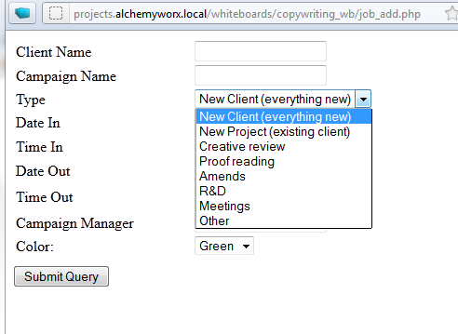
Copywriting
Copywriting
Please click here for explanation of all whiteboard tasks
Client’s
approval
Design
Client’s
approval
Email
Set up
Client’s
approval
DEPLOYMENT

Slide 11
Copywriting
Copywriting
CM needs to complete copywriting brief and send to copy editor Dan
CM to copywriter
Please add job to the copywriter whiteboard http://projects.alchemyworx.local/whiteboards/whiteboards/index.htm
Create a _copy_to_do folder in the client folder and a ‘done’ folder
Create a ‘copy’ folder in the project folder and an ‘archive’ folder. ( just like we do for design and HTML)
Complete copy brief or if amends ‘copy to do doc’ and place in the copy to do folder.
Please give as much information ( past mailings, brand guidelines, tone of voice, objectives, audience) as possible on brief.
If you require subject lines for the mailing please indicate this when you brief in the copy
With the brief create a ‘template’ for all client with all the information included and then just ‘populate’ the brief with additional/amended project info. I would also do this for design. ( Then you are not having to complete all the mandatory info everytime!)
Client’s
approval
Design
Client’s
approval
Email
Set up
Client’s
approval
DEPLOYMENT

Slide 12
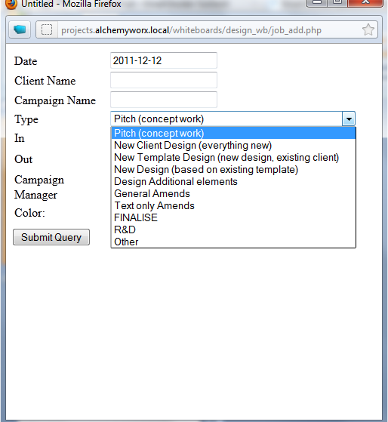
Design
Design
Explanation of design whiteboard tasks here
Campaign Mailing brief to brief new designs here
Client’s
approval
HTML
Client’s
approval
Email
set up
Client’s
approval
Deployment

Slide 13
Design
Design
CM needs to complete campaign mailing brief compiling following assets to brief the design team: Client brief + brand guidelines + image library if existing + Ideally, we’ll need copy at this stage
CM to Design:
CM would send design in a jpg format, and ask for amends. Designers to implement amends on the psd file, and send a revised jpg file to the CM/client for review and approval. When amends are briefed to design, please confirm which version of the design needs amending and do so by creating a ‘design to do’ document
Location: at root folder of each clients’ folder. Not specific to a project
Brief: confirm project number, and work to be done.
IMPORTANT: When a design is approved by a client, please brief on whiteboard to “finalise.” This has to be completed before moving onto HTML build.
Design finalising:
The design team will then prepare the files for coding, and place the final psd into the final folder. The design team is also responsible for purchasing the images from our AW library on istock (except if specified otherwise by client) at this stage.
Please ensure the client has signed off on all images we need to buy – if they amend after this stage extra costs may be applicable
Allow 30mn to 1hr for this step – and this needs to appear on the design board.
Designers need to confirm to the CM that the project is ready to be built, and would then send a path to the psd file.
CM to HTML:
Brief the build onto the html team only when the design team has confirmed that the psd is ready for the build and ALL QA finished. (Details of QA process here)
Note: If client only wants a design, as they’ll do the build, we’ll then send them the psd files and purchase the images from istockPhoto.
Client’s
approval
HTML
Client’s
approval
Email
set up
Client’s
approval
Deployment

Slide 14
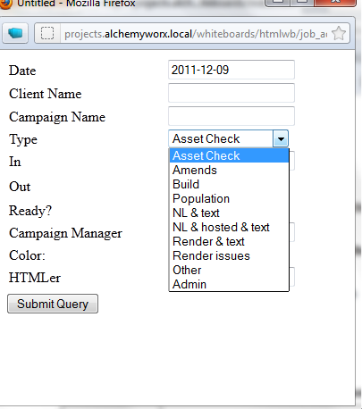
Design
Html process
Details of how PSD should be built in order for HTML to code most effectively
Explanation of ‘HTML’ whiteboard tasks
Detailed process - \\192.168.1.4\alchemy\production\html\2011\process_docs
Client’s
approval
HTML
Client’s
approval
Email
Set up
Client’s
approval
DEPLOYMENT

Slide 15
Design
Html build
CM to HTML:
If we receive PSD from client or third-party agency brief in an asset check before we start work.
If assets fail the check we will need to go back to the client to advise them on what needs to be fixed to progress the job, or if we can fix it advise that this is the approach we will take – chat to Claire or Lisa if you have to go back to the client re fixes as we might need to consider costs?
HTML will provide feedback on why assets have failed, so that you can provide feedback to your client
Please brief in this PSD check prior to putting the build task on the Whiteboard
If we designed the PSD:
CM to brief the html by placing a brief document into the html_to_do folder and adding the job to the HTML whiteboard with the date it is required by ( once job is complete please move the HTML to do document to the ‘done’ folder’)
Location: at root folder of each clients’ folder. Not specific to a project
Brief: confirm project number, php link if you already have one, and work to be done.
Client’s
approval
HTML
Client’s
approval
Email
Set up
Client’s
approval
DEPLOYMENT

Slide 16
Design
HTML continued…
HTML to CM:
-Html team to code email into html by creating the index file. They’ll create an index file (format: .htm or .html).
-Html team to provide a php link to the cm. CM to send the index preview link to the client for them to review the email (links, rendering, content, etc.)
-Html team will always implement the amends on the index file and reupload using the same path (ie. Preview/php links remain the same).
-As amends are briefed in always create a new HTML to document naming the document amends 1/amends 2/amends 3 as appropriate
Note: Index file = Images hosted on AW server – just to be shown to the client. This is NOT an email at this stage but an online version of the email.
If no deployment by AW: the CM sends html files to clients
Html team to create a ‘render.htm’ version of the email to be able to test it. Brief this into html accordingly.
Brief deployment team to send ‘render’ file for testing, and brief testing team to test.
When QA completed, send files to the client (Index.htm file + images folder).
If AW hosts images, send the render.htm file but rename it to newsletter.htm first.
Note: Render test = file created for testing purposes only, where images are hosted on AW temporarily. This is NOT the email to be broadcasted.
Client’s
approval
HTML
Client’s
approval
Email
Set up
Client’s
approval
DEPLOYMENT

Slide 17
Design
Creation of the email and campaign set up
File preparation: HTML team to create the EMAIL
When preview link signed off, brief html team to prepare the newsletter and text versions of the email (index) and to provide to CM through php link.
They will add the full paths to the images (host), add footer and hosted version & white list copy, add needed ESP codes (unsub, personalisation, etc.) which need to be briefed by the CM.
Client’s
approval
HTML
Client’s
approval
Email
set up
Client’s
approval
DEPLOYMENT

Slide 18
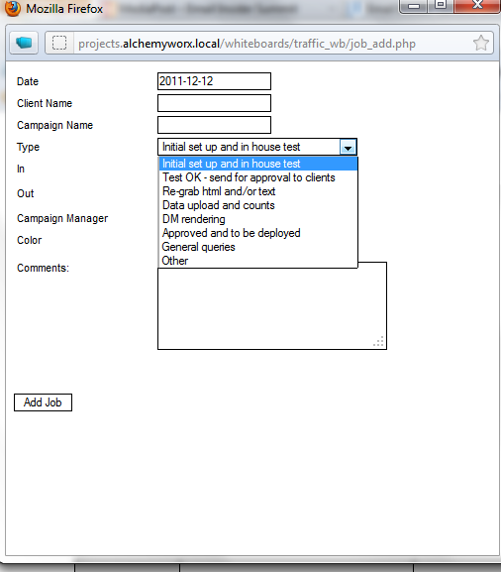
Design
Email set up in the ESP/deployment
CM - deployment: For full process please see here for details
Explanation of deployment whiteboard tasks here
To view flowchart on CM/Deployment process click here
-CM to brief deployment using whiteboard + CRF ( to do cover sheet)
Client’s
approval
HTML
Client’s
approval
Email
set up
Client’s
approval
DEPLOYMENT

Slide 19
Design
Set up and QA testing
Deployment and testing QA
-Deployment team to set up email (html and text) and/or forms on the client’s esp, as per the crf provided (initial set up)
-They then send a set of in house tests for the CM to check the email, and testers to test rendering and links.
CM to brief testing job onto the testing board and confirm subject line of the email into the ‘comments’ section.
-CM should also highlight on the testing board the job type
Full test ( links and render test)
Links only
Renders test
Test against previous errors ( eg. test HTML fixes on previous render/link issues)
-Testing team will email CM the ‘testing report’ also placing it in the QA folder ( CM to create QA folder within project folder on server)
- Testing team have developed a client specific checklist of aspects to test. Please let the testing team know if your client or campaign has specific requirements
- If you require forms testing, please indicate this with the testing team as there is a separate process
When internal deployment QA completed, test emails (or proofs, or approval emails) are sent to the client’s approval list.
Clients to check set up of the email (from address, unsubscribe, tracked links, text version, hosted version, etc.)
Client’s
approval
HTML
Client’s
approval
Email
set up
Client’s
approval
DEPLOYMENT

Slide 20
Design
Deployment and testing QA cont
CM - clients:
No deployment should happen unless the counts have been seen &/or approved by the client.
Once the client approves test emails, deployment and CM team to run final check together, and to deploy the email to the database and to the client’s seed list.
CM to confirm that email has been deployed
Client’s
approval
HTML
Client’s
approval
Email
set up
Client’s
approval
DEPLOYMENT

Slide 21
Data work & Post campaign reporting
Data work – please click here to view flow chart on CM/data process
Brief data and reporting team using the whiteboard.
Send an email with a clear brief containing: Project name, Data source name and path on ftp or server, detailed brief of what needs to be done. Provide path of where the data needs to be saved and what the final list(s) should be named.
When briefing in a list creation job, please populate the column for Number of Mailings/Lists with the amount of lists we will need to upload
Data team will confirm that work is completed as well as: counts, details of steps completed, data upload report
CM to confirm with clients and to brief traffic team and confirm that data is ready.
Costs: always ask the team to confirm if they’ll be any associated costs, and get them approved by the client (if not included in the retainer, project costs already) before the start of the data work
Snapshot reports and basic metrics report
-When a snapshot is requested, brief data and reporting team using the whiteboard and confirm the details of the report (basic metrics, click analysis, behavioural report, etc.)
When briefing in a snapshot request, please populate the column for Number of Mailings/Lists. with the number of mailings to take into consideration.
Send an email with clear brief, ESP details, list of messages to be taken into account, timelines and request a quote
Send quote to client for approval before starting the work
Once approved, confirm to the reporting team that they can go ahead with the report, according to the agreed timelines.

Slide 22
Quality Assurance/control
QA is everybody’s responsibility. The creative services and deployment team have their own dedicated QA resource. Details of what they check/QA can be found here.
Creative services
Deployment (rendering checks)
Campaign Management QA check. All CM’s should check all HTML previews, design JPG’s and all testing proofs before sending to the client. Full details of checks can be found here.
CM quality assurance – things to check

Slide 23
When mistakes happen….
Communication:
Inform Claire R as soon as you are aware an error has occurred.
Recording of errors (internally)
If a mistake/error occurs which results in a mailing being deployed or sent to clients with errors on. Or other areas which are sufficient enough to warrant an explanation to the client of what went wrong /or a process change we must complete the ‘error resolution form below’
Z:\production\campaign_manager\error_resolution\Error record form.doc
This form is to be completed in the first instance by the production staff member and their manager if the error was made by production. They will then send onto the CM/Claire for our input.
In most cases we will also have a wash up meeting to ensure everyone understands what went wrong and to put the necessary steps in place ( if required) to ensure mistake does not occur again.
It is important any additional process steps we suggest are implemented asap
Once implemented please update Claire R as I will chase to ensure everything has been actioned

Slide 24
Errors cont:
Root cause analysis form (external communication with client)
Depending on the severity of the error we will complete the below Root cause analysis form to send to the client, which puts all the info on the internal form into a client friendly explanation.
Z:\production\campaign_manager\error_resolution\RCA_AW_template.doc
Example - Z:\production\campaign_manager\error_resolution\cpw\RCA_CPW_AW_13052010.pdf

Slide 25
Job allocation: use the whiteboards *
All boards:
http://projects.alchemyworx.local/whiteboards/whiteboards/index.htm

Slide 26
Internal communications
Useful addresses:
eds@alchemyworx.com (Deployment team)
reporting@alchemyworx.com
cm@alchemyworx.com
html@alchemyworx.com
design@alchemyworx.com
testing@alchemyworx.com.
consulting@alchemyworx.com
Always put the PROJECT NUMBER in the subject line for all internal communications

Slide 27
Clients Timelines
Please find example of our branded project timelines excel doc to use
timeline_template_vs-actual.xlsx
Complete the proposed timelines and then complete actual as you go – so you can check we meeting all milestones

Slide 28
Invoicing process
Invoicing Process:
New invoice process using Synergist can be found here
..\Invoice Process.pptx

Slide 29
Holidays
Company policy:
The Company’s holiday year runs from1st June to 31st May each year. All holiday must be taken within the year it is accrued and may not be carried into the following year.
No more than 10 days may be taken consecutively.
Holidays request:
Notice:
1 or ½ day holiday – Give a week notice
1 week holiday -- Give 1 month notice
2 weeks holidays – Give 2 months notice
Process:
Send an email to Claire and Georgia and confirm dates requested
Claire to approve holidays on the ‘first ask, first serve’ basis and update holidays spreadsheet
Georgia will then confirm your remaining holidays left

Slide 30
Holidays Cover
Before you go on holidays:
List all projects per clients on a handover document and send to your line managers and your team on your last day at midday and organise a handover meeting
Ensure that the following is included:
PC password
Summary explanation of projects
Link to clients WIP
All client WIPS to be up to date
Try not to organise any conf call/meetings while you are away as the back-up might be too busy to attend
Please set your out of office on before you leave, informing all your clients on your last day in the office
When you get back:
Get an update from all your back ups on all your projects first thing

Slide 31
Send ‘big’ files to clients
Ask them if they have their own ftp, and place files there.
If not, please use Sharefile http://www.sharefile.com
ShareFile is a tool for sending, receiving, and organizing your business files online.
It can be used as a password-protected area for sharing information with clients and
partners, and it's an easy way to send files that are too large to e-mail.
Ask Dan or Emerson for login details and password both for yourself and your client to use

Slide 32
Alchemy Worx vision on emails
Email Worx – The Alchemy Worx’ newsletter
Subscribe to email worx here:
http://www.alchemyworx.com/c/newsletter
Read all previous archives here:
http://www.alchemyworx.com/emailworx/

Slide 33
Admin info
Path on server: \\192.168.1.4\alchemy\admin
You’ll find useful information on:
Alchemy Worx phone list
Expenses form
Sick form
Boardroom booking form
Templates
Booking in conference calls \\192.168.1.4\alchemy\admin\Conference calls\Conf_Call_Bookings_2011

Slide 34
Alchemy Worx Address
Alchemy Worx Ltd
4th Floor
1 New Oxford Street
London
WC1A 1LW
Nearest tube station: Holborn
Link to Google Map: http://maps.google.co.uk/maps?hl=en&source=hp&q=WC1A%201LW%20&um=1&ie=UTF-8&sa=N&tab=wl
Tel: 0870 908 8803
Fax: 0870 908 8804

Slide 35
Useful info about your phone

